Slide 1
Software Observability Made Easy: The Java Observability Toolkit
Jeff Williams | CTO and Co-Founder at Contrast Security
Notes:
Hi Everyone!
My name is Jeff Williams – Im CTO and Cofounder at Contrast Security
18 years ago I helped to found OWASP and I defined our mission…. “to make application security visible”
Why THAT mission? It’s simple.
The software market is broken -- consumers can’t tell the difference between secure software and insecure software
AND that means buyers can’t get a fair price when they put the effort into security
And who is going to write secure software if the market doesn’t value that!
The way we fix the software market is through SECURITY OBSERVABILITY!!
=====================
Title: Making the Unknown Unknowns Observable – Introducing JOT
Abstract: It’s easy to make things observable if you know them in advance. But what if you need observability into something you didn’t think to expose? A few examples…
The value of a variable deep in a library?
The callers of an encryption method?
Which routes contain access control checks?
The exact database query being sent when a user registers?
Say hello to the brand new open source Java Observability Toolkit (JOT) project. JOT will let ask almost any question of your software and get answers quickly – without any programming. You can select from predefined jots created by the community or create your own in a simple yaml format. There’s almost no limit to what you can observe. In this talk, we’ll demonstrate how to enable applications with JOT, show off some simple but powerful jots, and talk about the future of the project.

Slide 2
Fortune 100 Insurance company
“We are not running an insurance company per se, but a data and technology company”
DIGITAL
TRANSFORMATION
FALSE POSITIVES
OPEN
SOURCE
COMPLIANCE
CLOUD &
CONTAINERS
DEVOPS
ATTACKS
OUTSOURCING
LEGACY APPS
“Security is limiting the speed of innovation”
Notes:
This very large insurance company was spending millions on appsec – the whole traditional program.
They said that security was “IMPEDENCE” – “LIMITING THE SPEED OF INNOVATION”
Like everyone else, their appsec program has all of these challenges
But after millions of dollars… all they have is a big backlog of vulnerabilities
WHAT they DON”T have is security observability
Here’s why…

Slide 3
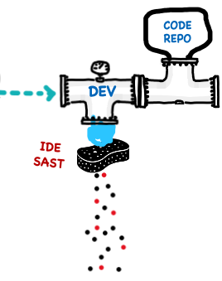
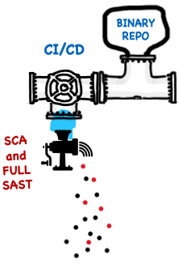
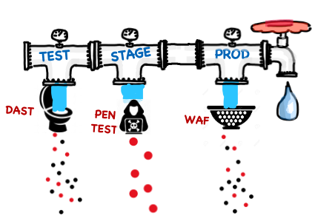
POOR SECURITY OBSERVABILITY
TRADITIONAL
SECURITY
(OUTSIDE – IN)
CUSTOM CODE
LIBRARIES
FLOW
BUSINESS VALUE
SECURITY BACKLOG
TRACK
RATE
CORRELATE
VALIDATE
TRIAGE
Notes:
We set up these elaborate pipelines with automated tools.
But at the end… what do we have? A list of problems.
And for many tools, the MAJORITY of those problems are false positives. THE MAJORITY.
That means people have to clean up the mess….
IMPEDENCE that slows the flow of value to customers.
Imagine that you had a good application inventory
And that across all those apps and apis
You have continuously generated evidence that
You have the right defenses for the right threats… and that those defenses are correct and effective
Then imagine you could get past even this, and you could do experimentation – asking questions of your application portfolio…
Where am I using non-parameterized statements?
What encryption algorithms am I using?
Which routes are missing access control checks?
So where do we go from here???

Slide 4
Instrumentation Changes everything
Notes:
This is the 94-50…. It’s an instrumented basketball.
It tells you dribble speed, shot rotation, arc of your shot, makes/misses, and a bunch more.
It also has a bunch of drills and metrics
I’ve been playing basketball for a LONG time.
After one hour, 94-50 let me know I was shooting too flat. Amazing.
There aren’t enough coaches for everyone.
But imagine if we can get an instrumented ball to the kids that need it
The coach doesn’t have to run every drill – they can be more strategic.
Doctors can be more helpful when your watch tracks your heart rate, temperature, and blood sugar continuously.
And SECURITY people can stop being in the critical path for every vulnerability
And work on critical strategic stuff like security architecture, threat modeling, and threat intelligence

Slide 5
What is DYNAMIC Security instrumentation?
Run instrumented code!
Instrumented
Code
Class
Class
Class
Platform
Agent
Loader
Transformer
Transformer adds security sensors to code
Original
Code
Class
Class
Class
Notes:
SO…. HOW DO WE MAKE APPLICATIONS AND APIS OBSERVABLE???
GREAT NEWS!! We don’t have to code it all in. We can INSTRUMENT it in without changing about the way people build, test, or deploy software.
Instrumenting software IS EASY!! It’s an amazingly powerful technicque for creating security observability.
We add an agent to the application. Not an OS level agent. For Java it’s a jar file.
As the code loads, the agent SURGICALLY adds sensors to exactly right methods.
We can record and analyze the telemetry from these sensors to keep an eye on everything in the software.
The only limit is your imagination.
I’m going to show you three things you can do today!

Slide 6
VISUALIZING SECURITY OBSERVABILITY
Security specialists translate new threats into SENSORS
Developer uses application normally, GETS INSTANT, Accurate FEEDBACK
Instrumentation Provides instant security feedbACK
Notes:
I spent years doing penetration testing and code review
We’d spend days figuring out how to send just the right request into an application to make it break.
Like trying to blow up the death star
But what if we had a friend living inside the application. They have access to the code, the HTTP traffic, the libraries, the configuration, the data flow, backend connections, everything.
Anything you want to know --- your friend tells you all the details.
You don’t have to attack your application…. Just do normal testing.
If your friend sees untrusted data flow through the application into a SQL query without being escaped or parameerized…. He shouts out “HEY SQL INJECTION”
You don’t need to be an expert – you don’t need to exploit anything.
ANYONE can be a pentester with a smart enough agent!

Slide 7
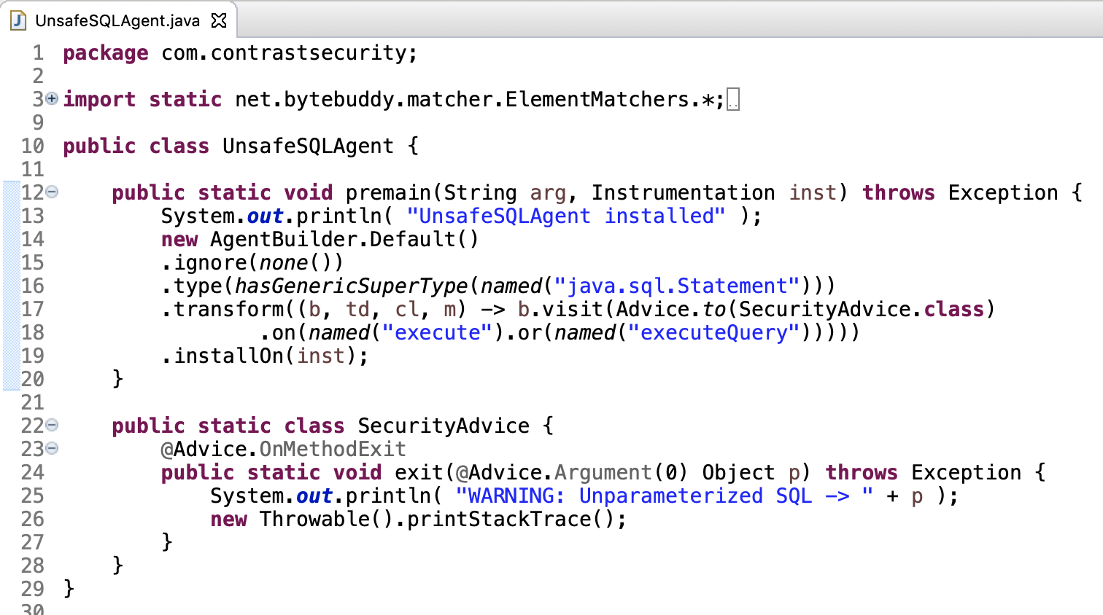
SECURITY OBSERVABILITY with Instrumentation
Put SecurityAdvice inside Statement.execute
Report rule violation when it happens
Notes:
You can get started right now.
I hate to show code… but I want you to understand how easy this is…
This is the ENTIRE code to a simple but powerful Java instrumentation agent for SQL Injection
This top part just says to put a sensor into any methods that query a database
The sensor itself reports query and where the query was called from.
Works on any Java app…
You just add this agent to your application
No code changes. No experts. Just a heads up on EVERYWHERE you’re using a non-Parameterized query.
And USE IT NORMALLY! You don’t need to know anything about security.
Simple, safe, and remarkably effective without any code changes for all the apps

Slide 8
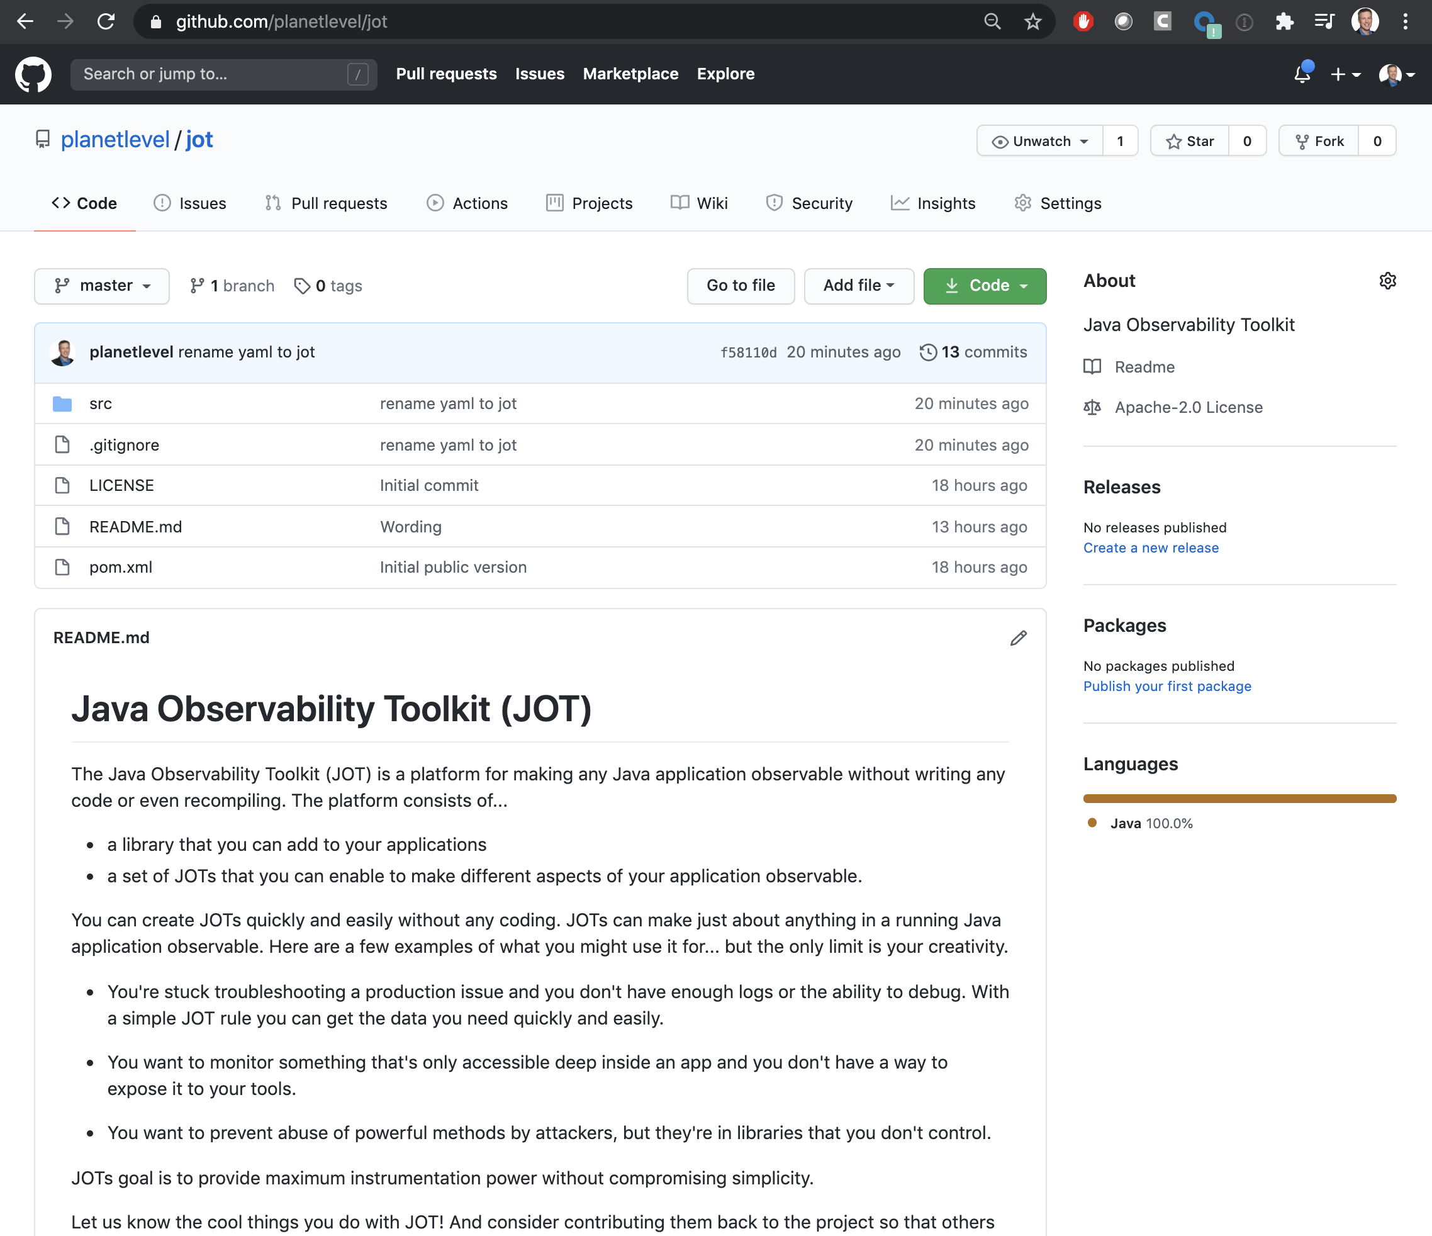
FREE Open source instrumentation: The Java Observability Toolkit (JOT)
https://github.com/planetlevel/jot
Notes:
It’s not that hard to write your own instrumentation…. But to make it easier,
I created an open source platform so that you can create sensors fast and easy without any coding.
The Java Observability

Slide 9
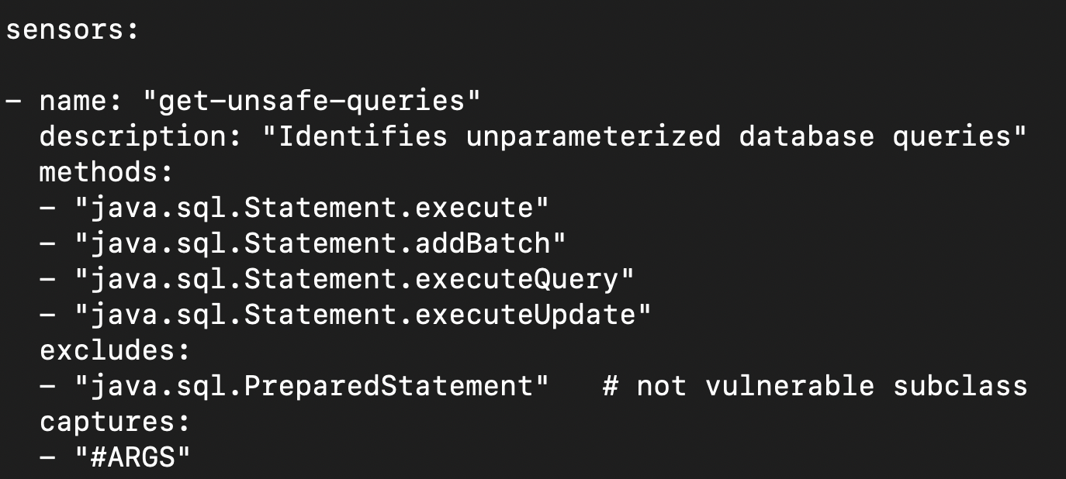
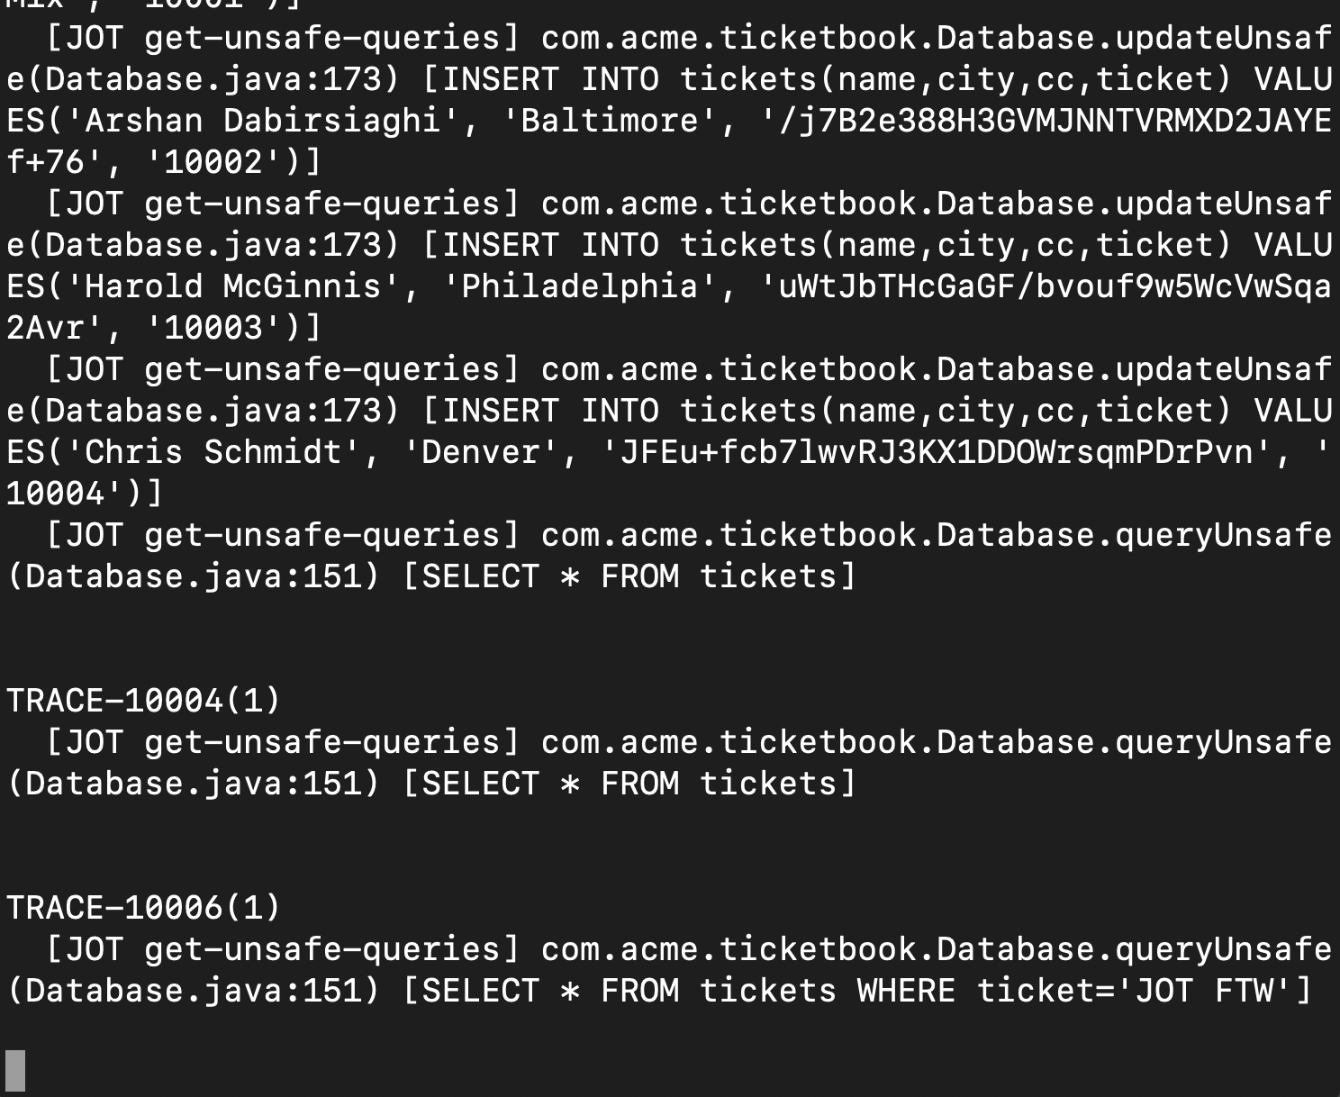
DEMO: SQL Injection
Imagine your normal test cases fail for security reasons if you make security mistake
Notes:
You just add this agent to your application
No code changes. No experts. Just a heads up on EVERYWHERE you’re using a non-Parameterized query.
And USE IT NORMALLY! You don’t need to know anything about security.
Simple, safe, and remarkably effective without any code changes for all the apps

Slide 10
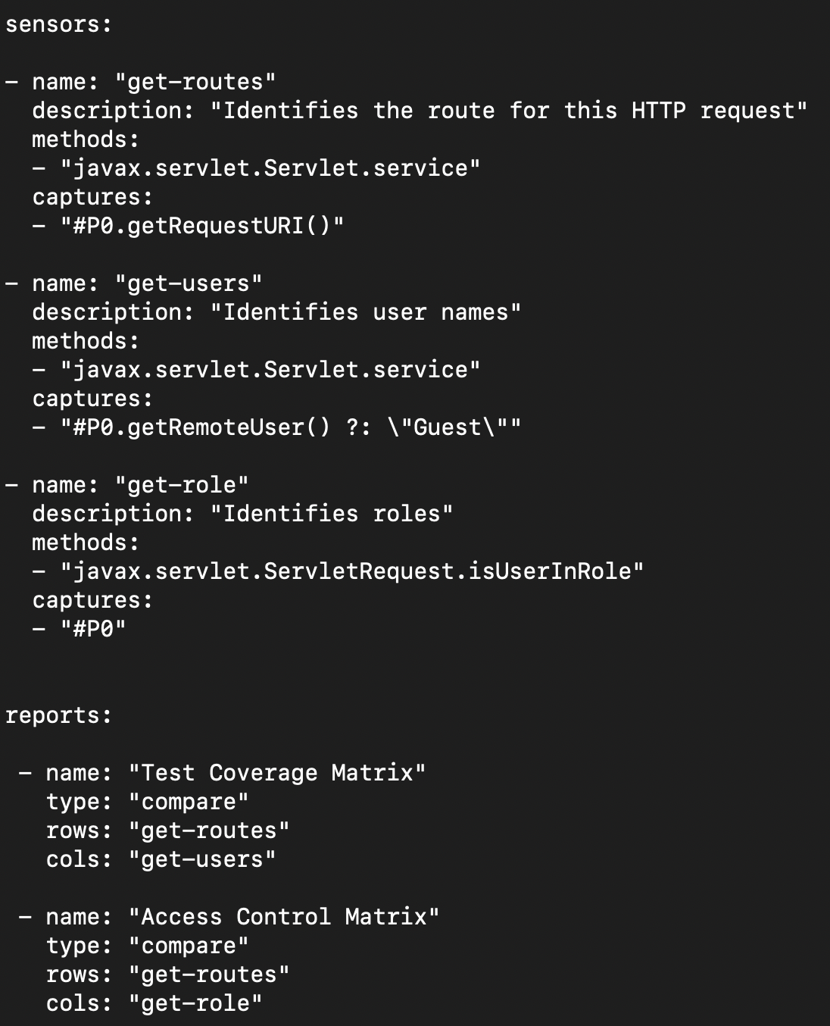
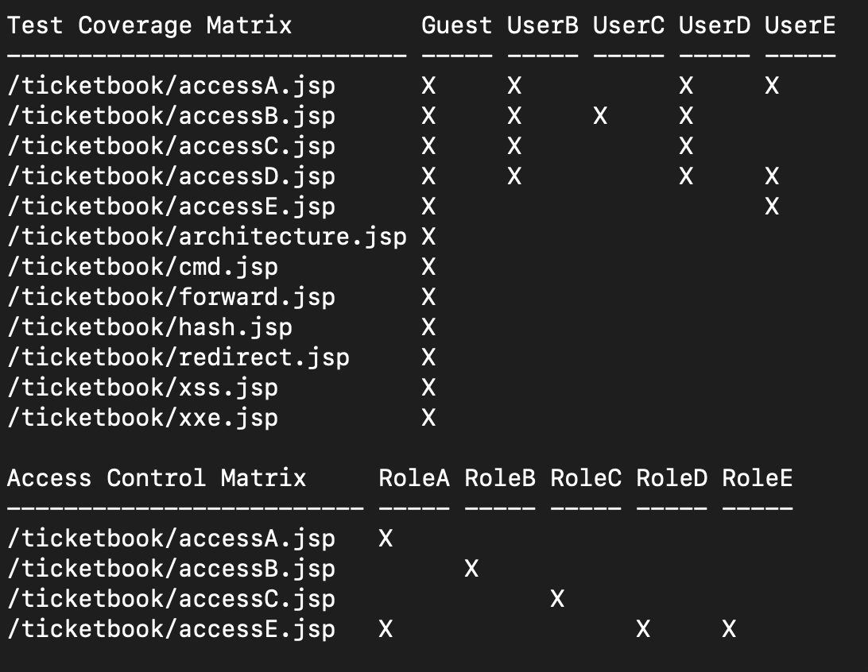
DEMO: Access Control!
Notes:
You just add this agent to your application
No code changes. No experts. Just a heads up on EVERYWHERE you’re using a non-Parameterized query.
And USE IT NORMALLY! You don’t need to know anything about security.
Simple, safe, and remarkably effective without any code changes for all the apps

Slide 11
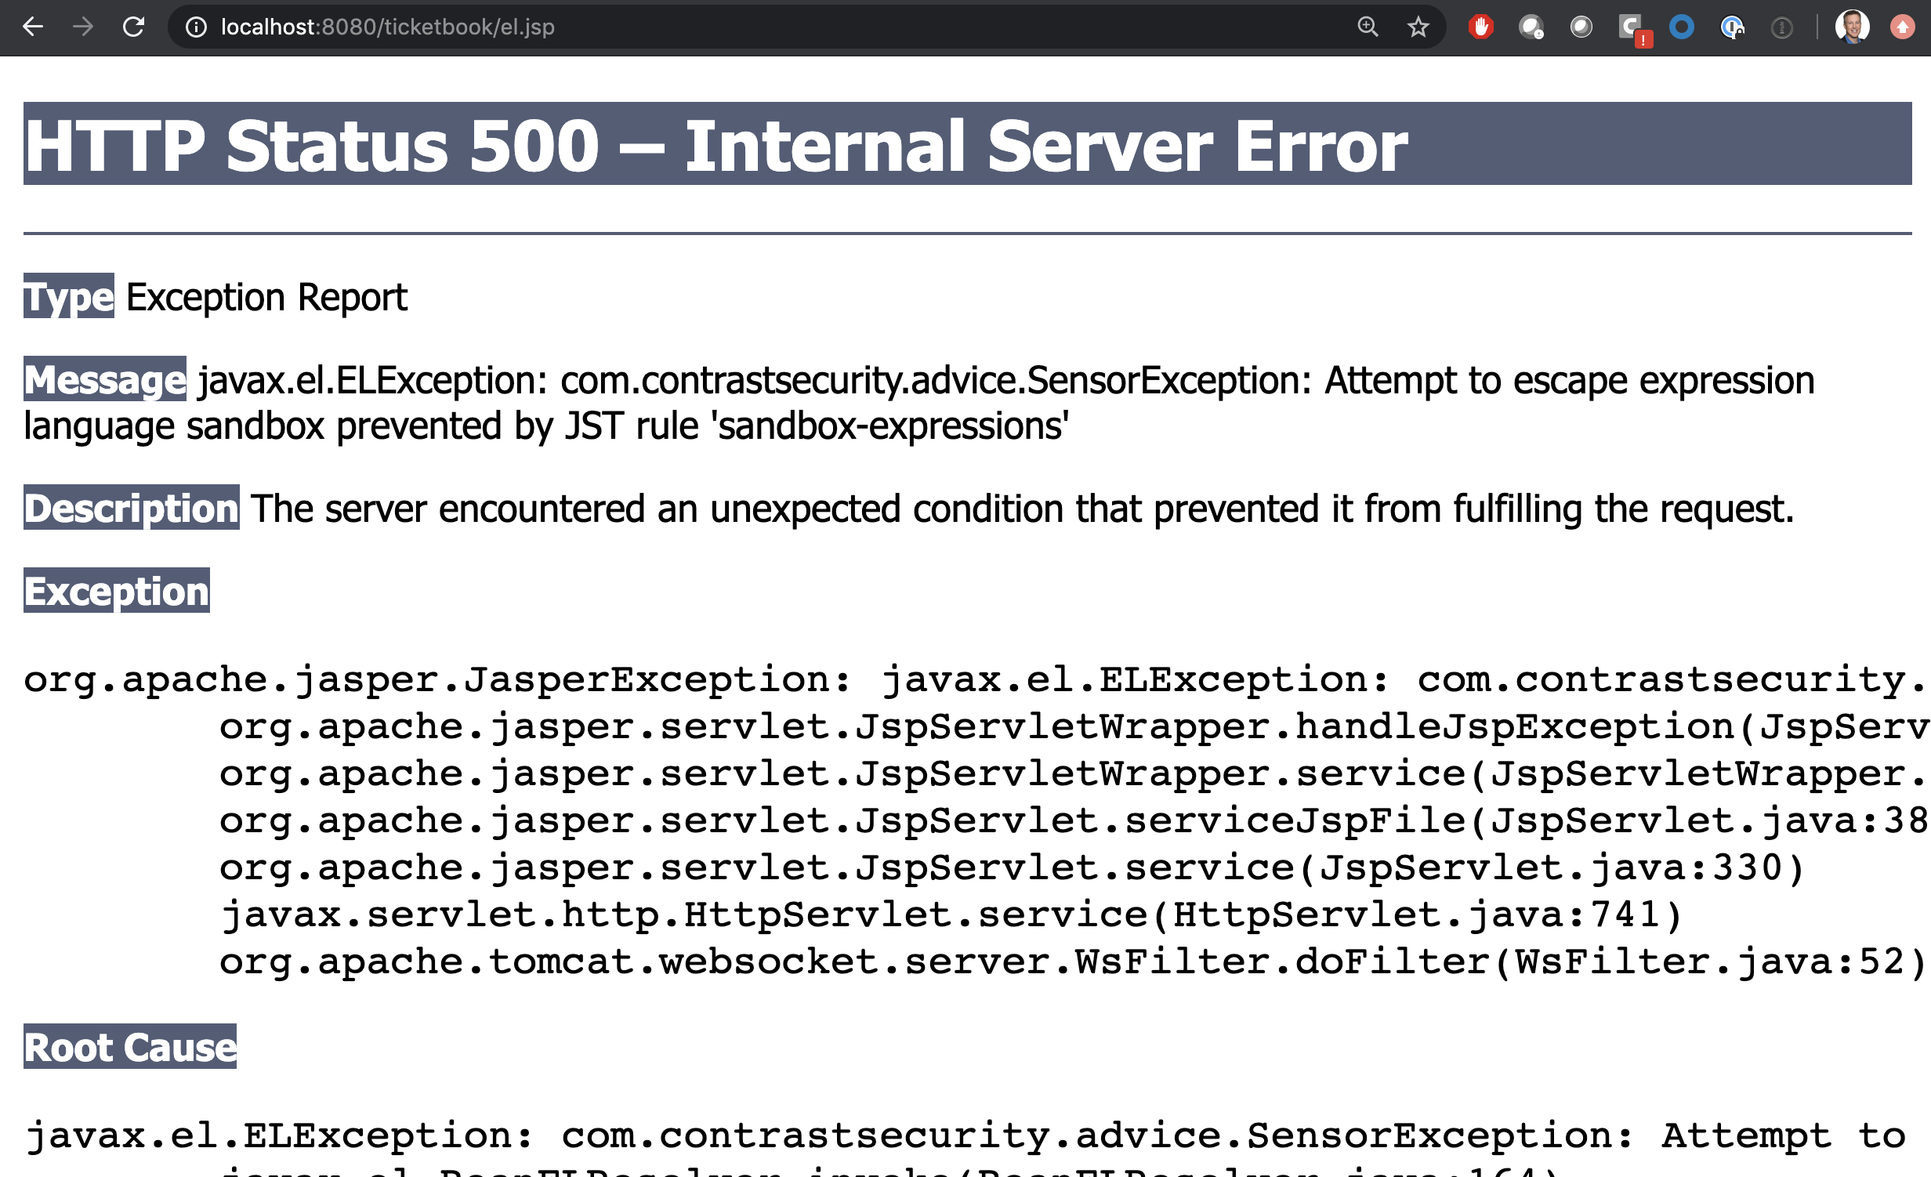
DEMO: Preventing EXPRESSION LANGUAGE INJECTION ATTACKS with Instrumentation!
Runtime Protection!

Slide 12
IAST
RASP
Interactive Application Security Testing is simply using instrumentation to detect vulnerabilities. USE IT IN DEVELOPMENT
Runtime Application Self-Protection is simply using instrumentation to detect attacks and prevent exploits. USE IT IN PRODUCTION
In DEV and TEST
In PROD
Exploit Prevented
✘
Vulnerability
Confirmed
HTTP Sensors
Code Sensors
Data Flow Sensors
Control Flow Sensors
HTTP Sensors
Code Sensors
Data Flow Sensors
Control Flow Sensors
Library Sensors
Config Sensors
Backend Sensors
Library Sensors
Config Sensors
Backend Sensors
Notes:
You don’t have to write all this stuff yourself.
Although you certainly CAN
But there are many products in the market that use instrumentation for security testing and protection.
IAST is…
RASP is….
DSCA too!!!
There is almost no limit to what you can do with INSTRUMENTATION
Detecting a vulnerability and preventing an exploit actually aren’t very diffiuclt.
Like how seeing an open window isn’t that different from closing it when an attacker tries to break in.
It’s totally insane to have two totally different technologies to do this same thing.

Slide 13
SECURITY OBSERVABILITY ACCELERATES INNOVATION
SEC
SECURITY OBSERVABILITY
(INSIDE – OUT)
DEV
OPS
Instant Feedback
Vulnerabilities
Attacks
CUSTOM CODE
Instrumentation
(IAST, SCA, RASP)
CUSTOM CODE
LIBRARIES
LIBRARIES
FRAMEWORKS
FRAMEWORKS
DEV
TEST
STAGE
PROD
APP SERVER
APP SERVER
RUNTIME
RUNTIME
CI/CD
FLOW
BUSINESS VALUE +
CONTINUOUS ASSURANCE
Continuous automated security testing
and exploit prevention
Self-
Testing
Self-Protecting
Notes:
Modern Security is different.
First, we will test the entire fully assembled application stack, not source code and components separately.
We will use security instrumentation to inject sensors directly into the app, so we can measure what’s actually happening. This is entirely automated. No changes to code or process.
This instrumentation allows us to accurately identify vulnerabilities in real time, so we can feed them to developers and they can fix them without breaking stride.
But it doesn’t stop there — the instrumentation continues to work right through the pipeline.
Continuous security testing at every step. Feedback on open source libraries too.
And when the app goes into production, you get visibility into who is attacking and what they’re trying.
The instrumentation automatically prevents most vulnerabilities from being exploited too.
That means you’re safe while you go back and fix vulnerabilities with no fire drill.
All this means that your pipeline can run full speed.
This is the essence of DEV-SEC-OPS. We’re using the power of security instrumentation to create harmony between security, development, and operations teams. We fixed the broken economics of software security and now security contributes to flow.

Slide 14
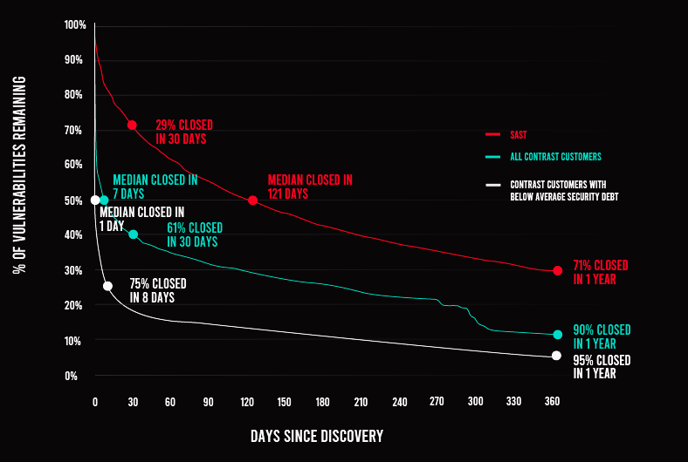
OBSERVABILITY YIELDS a 40x improvement in MTTR over SCANNING
MEAN TIME TO REMEDIATE
– SAST
– IAST
– IAST (BELOW AVERAGE BACKLOG)
* Data from ContraST 2020 APPSEC Observability Report and Veracode 2020 SOSS REPORT

Slide 15
Development
Harmony
Security
Notes:
Application security isn’t hopeless
Remember that INSURANCE company I mentioned?
After a year, they have close to 1000 applications enabled with SECURITY OBSERVABILITY
They’ve worked off most of their app vulnerability backlog
And security is no longer an IMPEDENCE
The key to appsec is getting everyone working together
And the key to THAT is security observability
So everyone has access to instant, accurate security information
I’m not saying that technology alone can solve our security issues.
Good security requires the right mix of culture, people, process, and technology.
REMEMBER: You can’t secure what you can’t see

Slide 16
A security instrumentation-based application security platform
https://www.contrastsecurity.com
Protect against attacks with RASP
Find vulnerabilities with IAST
Secure open-source with SCA
Notes:
If YOU want to skip the DIY stuff and go right to the PRO tools…
I’m VERY proud to tell you that over 3200 organizations are already using CONTRAST Community Edition
It’s totally free and full strength forever – for ONE APP.
Please reach out and me know what you think.
Now I’d love to take any questions you might have about anything.

Slide 17
Ask me anything!
AFTER Q/A, HEAD BACK TO THE S.O.S PAGE TO SELECT
YOUR SESSION FOR THE SECOND BREAKOUT!
Link to the S.O.S page in the Zoom chat and in your calendar

